Slide 1
SEVZI ZC467
Computer Networks
Contact Session – 4
Prabhu Subramanian

Slide 2

IMP Note to Self

Slide 3
Agenda
Socket Programming with TCP / UDP
Multiplexing
Sliding window

Slide 4
Important Note to Students
It is important to know that just login to the session does not guarantee the attendance.
Once you join the session, continue till the end to consider you as present in the class.
IMPORTANTLY, you need to make the class more interactive by responding to Professors queries in the session.
Whenever Professor calls your number / name, you need to respond, otherwise it will be considered as ABSENT

Slide 5
Socket programming
Goal: learn how to build client/server application that communicate using sockets
Socket API
introduced in BSD4.1 UNIX, 1981
explicitly created, used, released by apps
client/server paradigm
two types of transport service via socket API:
  unreliable datagram
  reliable, byte stream-oriented
socket
a host-local,
application-created,
OS-controlled interface (a “door”) into which
application process can both send and
receive messages to/from another application process

Slide 6
Socket-programming using TCP
Socket: a door between application process and end-end-transport protocol (UCP or TCP)
TCP service: reliable transfer of bytes from one process to another
controlled by
application
developer
controlled by
application
developer
process
process
socket
socket
TCP with
buffers,
variables
TCP with
buffers,
variables
controlled by
operating
system
controlled by
operating
system
internet
host or
server
host or
server

Slide 7
Socket programming with TCP
Client must contact server
server process must first be running
server must have created socket (door) that welcomes client’s contact
Client contacts server by:
creating client-local TCP socket
specifying IP address, port number of server process
When client creates socket: client TCP establishes connection to server TCP
When contacted by client, server TCP creates new socket for server process to communicate with client
  allows server to talk with multiple clients
  source port numbers used to distinguish clients (more in Chap 3)
application viewpoint
TCP provides reliable, in-order
transfer of bytes (“pipe”)
between client and server

Slide 8
Client/server socket interaction: TCP
Server (running on hostid)
Client
create socket,
port=x, for
incoming request:
welcomeSocket =
ServerSocket()
TCP
connection setup
create socket,
connect to hostid, port=x
wait for incoming
connection request
connectionSocket =
welcomeSocket.accept()
clientSocket =
Socket()
send request using
clientSocket
read request from
connectionSocket
write reply to
connectionSocket
read reply from
clientSocket
close
connectionSocket
close
clientSocket

Slide 9
Stream jargon
A stream is a sequence of characters that flow into or out of a process.
An input stream is attached to some input source for the process, e.g., keyboard or socket.
An output stream is attached to an output source, e.g., monitor or socket.
Client
process
client TCP socket

Slide 10
Socket programming with TCP
Example client-server app:
1) client reads line from standard input (inFromUser stream) , sends to server via socket (outToServer stream)
2) server reads line from socket
3) server converts line to uppercase, sends back to client
4) client reads, prints modified line from socket (inFromServer stream)

Slide 11
Example: Java client (TCP)
import java.io.*;
import java.net.*;
class TCPClient {
public static void main(String argv[]) throws Exception
{
String sentence;
String modifiedSentence;
BufferedReader inFromUser =
new BufferedReader(new InputStreamReader(System.in));
Socket clientSocket = new Socket("hostname", 6789);
DataOutputStream outToServer =
new DataOutputStream(clientSocket.getOutputStream());
Create
input stream
Create
client socket,
connect to server
Create
output stream
attached to socket

Slide 12
Example: Java client (TCP), cont.
Create
input stream
attached to socket
BufferedReader inFromServer =
new BufferedReader(new
InputStreamReader(clientSocket.getInputStream()));
sentence = inFromUser.readLine();
outToServer.writeBytes(sentence + '\n');
modifiedSentence = inFromServer.readLine();
System.out.println("FROM SERVER: " + modifiedSentence);
clientSocket.close();
}
}
Send line
to server
Read line
from server

Slide 13
Example: Java server (TCP)
import java.io.*;
import java.net.*;
class TCPServer {
public static void main(String argv[]) throws Exception
{
String clientSentence;
String capitalizedSentence;
ServerSocket welcomeSocket = new ServerSocket(6789);
while(true) {
Socket connectionSocket = welcomeSocket.accept();
BufferedReader inFromClient =
new BufferedReader(new
InputStreamReader(connectionSocket.getInputStream()));
Create
welcoming socket
at port 6789
Wait, on welcoming
socket for contact
by client
Create input
stream, attached
to socket

Slide 14
Example: Java server (TCP), cont
Create output
stream, attached
to socket
DataOutputStream outToClient =
new DataOutputStream(connectionSocket.getOutputStream());
clientSentence = inFromClient.readLine();
capitalizedSentence = clientSentence.toUpperCase() + '\n';
outToClient.writeBytes(capitalizedSentence);
}
}
}
Read in line
from socket
Write out line
to socket
End of while loop,
loop back and wait for
another client connection

Slide 15
Chapter 2: Application layer
2.6 P2P applications
2.7 Socket programming with TCP
2.8 Socket programming with UDP
2.1 Principles of network applications
2.2 Web and HTTP
2.3 FTP
2.4 Electronic Mail
  SMTP, POP3, IMAP
2.5 DNS

Slide 16
Socket programming with UDP
UDP: no “connection” between client and server
no handshaking
sender explicitly attaches IP address and port of destination to each packet
server must extract IP address, port of sender from received packet
UDP: transmitted data may be received out of order, or lost
application viewpoint
UDP provides unreliable transfer
of groups of bytes (“datagrams”)
between client and server

Slide 17
Client/server socket interaction: UDP
Server (running on hostid)
Client
create socket,
port= x.
create socket,
clientSocket =
DatagramSocket()
serverSocket =
DatagramSocket()
Create datagram with server IP and
port=x; send datagram via
clientSocket
read datagram from
serverSocket
write reply to
serverSocket
specifying
client address,
port number
read datagram from
clientSocket
close
clientSocket

Slide 18
Example: Java client (UDP)
Client
process
Input: receives packet (recall thatTCP received “byte stream”)
Output: sends packet (recall
that TCP sent “byte stream”)
client UDP socket

Slide 19
Example: Java client (UDP)
import java.io.*;
import java.net.*;
class UDPClient {
public static void main(String args[]) throws Exception
{
BufferedReader inFromUser =
new BufferedReader(new InputStreamReader(System.in));
DatagramSocket clientSocket = new DatagramSocket();
InetAddress IPAddress = InetAddress.getByName("hostname");
byte[] sendData = new byte[1024];
byte[] receiveData = new byte[1024];
String sentence = inFromUser.readLine();
sendData = sentence.getBytes();
Create
input stream
Create
client socket
Translate
hostname to IP
address using DNS

Slide 20
Example: Java client (UDP), cont.
Create datagram with data-to-send,
length, IP addr, port
DatagramPacket sendPacket =
new DatagramPacket(sendData, sendData.length, IPAddress, 9876);
clientSocket.send(sendPacket);
DatagramPacket receivePacket =
new DatagramPacket(receiveData, receiveData.length);
clientSocket.receive(receivePacket);
String modifiedSentence =
new String(receivePacket.getData());
System.out.println("FROM SERVER:" + modifiedSentence);
clientSocket.close();
}
}
Send datagram
to server
Read datagram
from server

Slide 21
Example: Java server (UDP)
import java.io.*;
import java.net.*;
class UDPServer {
public static void main(String args[]) throws Exception
{
DatagramSocket serverSocket = new DatagramSocket(9876);
byte[] receiveData = new byte[1024];
byte[] sendData = new byte[1024];
while(true)
{
DatagramPacket receivePacket =
new DatagramPacket(receiveData, receiveData.length);
serverSocket.receive(receivePacket);
Create
datagram socket
at port 9876
Create space for
received datagram
Receive
datagram

Slide 22
Example: Java server (UDP), cont
String sentence = new String(receivePacket.getData());
InetAddress IPAddress = receivePacket.getAddress();
int port = receivePacket.getPort();
String capitalizedSentence = sentence.toUpperCase();
sendData = capitalizedSentence.getBytes();
DatagramPacket sendPacket =
new DatagramPacket(sendData, sendData.length, IPAddress,
port);
serverSocket.send(sendPacket);
}
}
}
Get IP addr
port #, of
sender
Create datagram
to send to client
Write out
datagram
to socket
End of while loop,
loop back and wait for
another datagram

Slide 23

Transport services and protocols
application
transport
network
data link
physical
provide logical communication between app processes running on different hosts
transport protocols run in end systems
  send side: breaks app messages into segments, passes to network layer
  rcv side: reassembles segments into messages, passes to app layer
more than one transport protocol available to apps
  Internet: TCP and UDP
logical end-end transport
application
transport
network
data link
physical

Slide 24
Port numbers for Internet model
16 bit numbers ( between 0 and 65,535)
Client Program - ephemeral port - chosen randomly - transport layer software running on the client host
Server program - well known port numbers- Universal port numbers

Slide 25
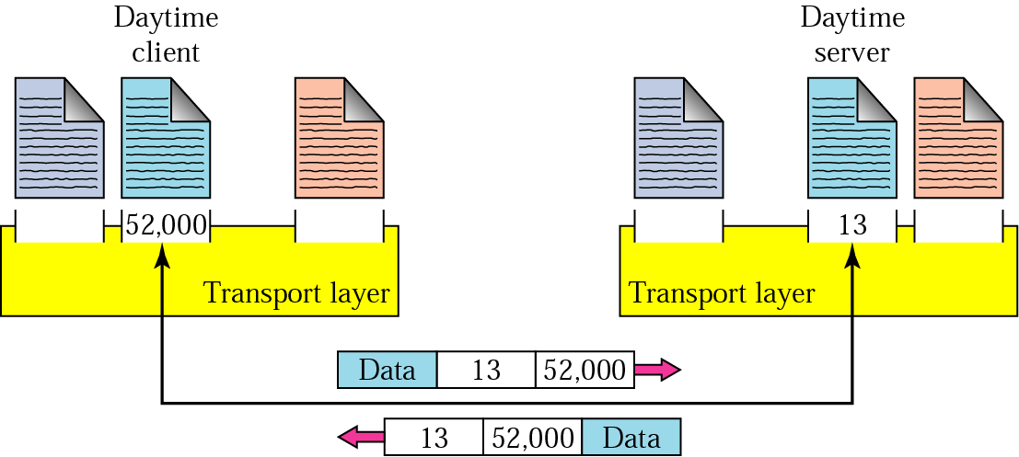
Port numbers

Slide 26
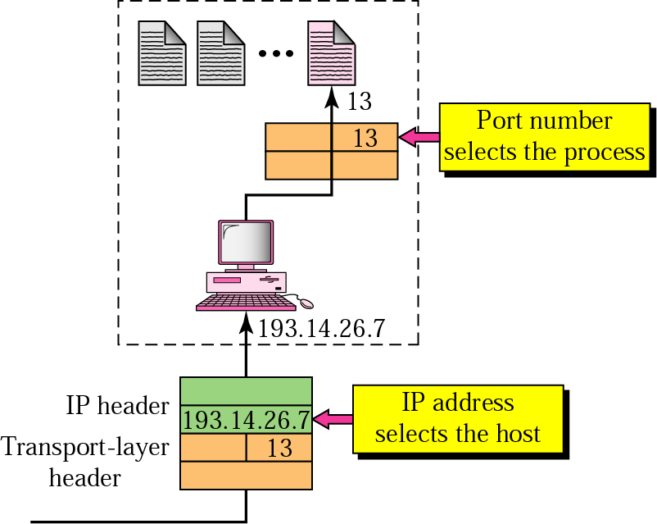
IP addresses versus port numbers

Slide 27
Multiplexing/demultiplexing
Demultiplexing at rcv host:
Multiplexing at send host:
delivering received segments
to correct socket
gathering data from multiple
sockets, enveloping data with
header (later used for
demultiplexing)
= socket
= process
application
application
application
P4
P3
P1
P2
P1
transport
transport
transport
network
network
network
link
link
link
physical
physical
physical
host 1
host 2
host 3

Slide 28
How demultiplexing works
host receives IP datagrams
  each datagram has source IP address, destination IP address
  each datagram carries 1 transport-layer segment
  each segment has source, destination port number
host uses IP addresses & port numbers to direct segment to appropriate socket
32 bits
source port #
dest port #
other header fields
application
data
(message)
TCP/UDP segment format

Slide 29
Connectionless demultiplexing
When host receives UDP segment:
  checks destination port number in segment
  directs UDP segment to socket with that port number
IP datagrams with different source IP addresses and/or source port numbers directed to same socket
Create sockets with port numbers:
DatagramSocket mySocket1 = new DatagramSocket(12534);
DatagramSocket mySocket2 = new DatagramSocket(12535);
UDP socket identified by two-tuple:
(dest IP address, dest port number)

Slide 30
Connectionless demux (cont)
DatagramSocket serverSocket = new DatagramSocket(6428);
P2
P1
P3
P1
SP: 6428
SP: 6428
DP: 9157
DP: 5775
SP: 9157
SP: 5775
client
IP: A
DP: 6428
server
IP: C
DP: 6428
Client
IP:B
SP provides “return address”

Slide 31
Connection-oriented demux
TCP socket identified by 4-tuple:
  source IP address
  source port number
  dest IP address
  dest port number
recv host uses all four values to direct segment to appropriate socket
Server host may support many simultaneous TCP sockets:
  each socket identified by its own 4-tuple
Web servers have different sockets for each connecting client
  non-persistent HTTP will have different socket for each request

Slide 32
Connection-oriented demux (cont)
P1
P4
P5
P6
P2
P1
P3
SP: 5775
DP: 80
S-IP: B
D-IP:C
SP: 9157
SP: 9157
client
IP: A
DP: 80
server
IP: C
DP: 80
Client
IP:B
S-IP: A
S-IP: B
D-IP:C
D-IP:C

Slide 33
Connection-oriented demux: Threaded Web Server
P1
P4
P2
P1
P3
SP: 5775
DP: 80
S-IP: B
D-IP:C
SP: 9157
SP: 9157
client
IP: A
DP: 80
server
IP: C
DP: 80
Client
IP:B
S-IP: A
S-IP: B
D-IP:C
D-IP:C

Slide 34
Chapter 3 outline
3.5 Connection-oriented transport: TCP
  segment structure
  reliable data transfer
  flow control
  connection management
3.6 Principles of congestion control
3.7 TCP congestion control
3.1 Transport-layer services
3.2 Multiplexing and demultiplexing
3.3 Connectionless transport: UDP
3.4 Principles of reliable data transfer

Slide 35
UDP: User Datagram Protocol [RFC 768]
“no frills,” “bare bones” Internet transport protocol
“best effort” service, UDP segments may be:
  lost
  delivered out of order to app
connectionless:
  no handshaking between UDP sender, receiver
  each UDP segment handled independently of others
Why is there a UDP?
no connection establishment (which can add delay)
simple: no connection state at sender, receiver
small segment header
no congestion control: UDP can blast away as fast as desired

Slide 36
UDP: more
often used for streaming multimedia apps
  loss tolerant
  rate sensitive
other UDP uses
  DNS
  SNMP
reliable transfer over UDP: add reliability at application layer
  application-specific error recovery!
32 bits
Length, in
bytes of UDP
segment,
including
header
source port #
dest port #
length
checksum
Application
data
(message)
UDP segment format

Slide 37
UDP checksum
Goal: detect “errors” (e.g., flipped bits) in transmitted segment
Sender:
treat segment contents as sequence of 16-bit integers
checksum: addition (1’s complement sum) of segment contents
sender puts checksum value into UDP checksum field
Receiver:
compute checksum of received segment
check if computed checksum equals checksum field value:
  NO - error detected
  YES - no error detected. But maybe errors nonetheless? More later ….

Slide 38
Internet Checksum Example
Note
  When adding numbers, a carryout from the most significant bit needs to be added to the result
Example: add two 16-bit integers
1 1 1 1 0 0 1 1 0 0 1 1 0 0 1 1 0
1 1 1 0 1 0 1 0 1 0 1 0 1 0 1 0 1
1 1 0 1 1 1 0 1 1 1 0 1 1 1 0 1 1
1 1 0 1 1 1 0 1 1 1 0 1 1 1 1 0 0
1 0 1 0 0 0 1 0 0 0 1 0 0 0 0 1 1
wraparound
sum
checksum
Notes:
Kurose and Ross forgot to say anything about wrapping the carry and adding it to low order bit

Slide 39
Chapter 3 outline
3.5 Connection-oriented transport: TCP
  segment structure
  reliable data transfer
  flow control
  connection management
3.6 Principles of congestion control
3.7 TCP congestion control
3.1 Transport-layer services
3.2 Multiplexing and demultiplexing
3.3 Connectionless transport: UDP
3.4 Principles of reliable data transfer

Slide 40
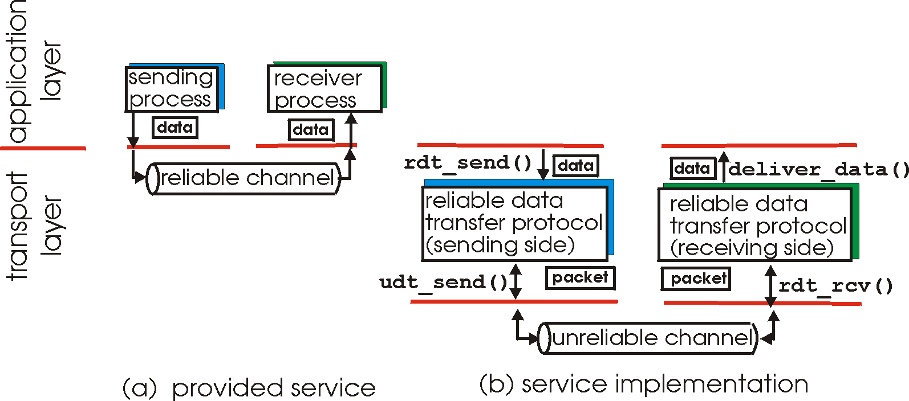
Principles of Reliable data transfer
important in app., transport, link layers
top-10 list of important networking topics!
characteristics of unreliable channel will determine complexity of reliable data transfer protocol (rdt)

Slide 41
Principles of Reliable data transfer
important in app., transport, link layers
top-10 list of important networking topics!
characteristics of unreliable channel will determine complexity of reliable data transfer protocol (rdt)

Slide 42
Principles of Reliable data transfer
important in app., transport, link layers
top-10 list of important networking topics!
characteristics of unreliable channel will determine complexity of reliable data transfer protocol (rdt)

Slide 43
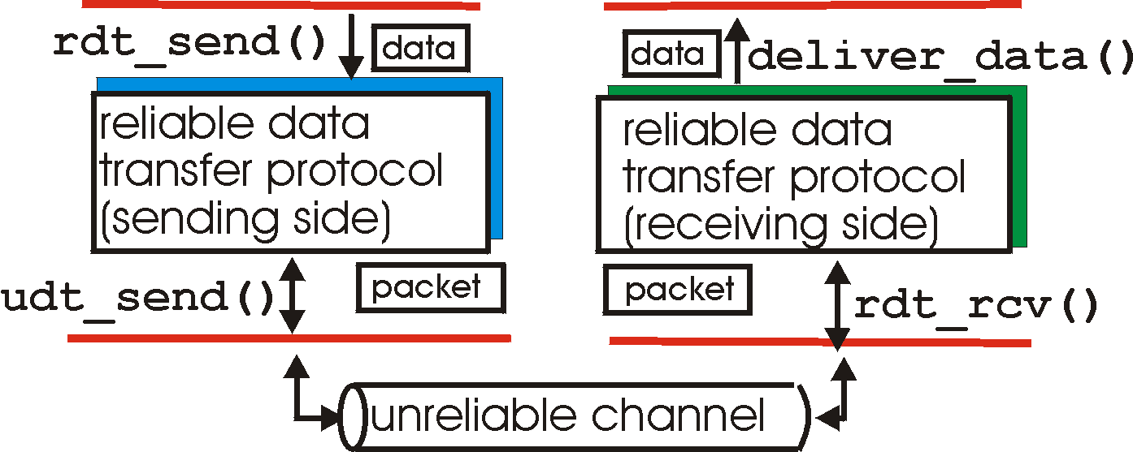
Reliable data transfer: getting started
rdt_send(): called from above, (e.g., by app.). Passed data to
deliver to receiver upper layer
deliver_data(): called by rdt to deliver data to upper
send
side
receive
side
udt_send(): called by rdt,
to transfer packet over
unreliable channel to receiver
rdt_rcv(): called when packet arrives on rcv-side of channel

Slide 44
Reliable data transfer: getting started
We’ll:
incrementally develop sender, receiver sides of reliable data transfer protocol (rdt)
consider only unidirectional data transfer
  but control info will flow on both directions!
use finite state machines (FSM) to specify sender, receiver
event causing state transition
actions taken on state transition
state: when in this “state” next state uniquely determined by next event
state
1
state
2
event
actions

Slide 45
Rdt1.0: reliable transfer over a reliable channel
underlying channel perfectly reliable
  no bit errors
  no loss of packets
separate FSMs for sender, receiver:
  sender sends data into underlying channel
  receiver read data from underlying channel
Wait for call from above
rdt_send(data)
Wait for call from below
rdt_rcv(packet)
extract (packet,data)
deliver_data(data)
packet = make_pkt(data)
udt_send(packet)
sender
receiver

Slide 46
Rdt2.0: channel with bit errors
underlying channel may flip bits in packet
  checksum to detect bit errors
the question: how to recover from errors:
  acknowledgements (ACKs): receiver explicitly tells sender that pkt received OK
  negative acknowledgements (NAKs): receiver explicitly tells sender that pkt had errors
  sender retransmits pkt on receipt of NAK
new mechanisms in rdt2.0 (beyond rdt1.0):
  error detection
  receiver feedback: control msgs (ACK,NAK) rcvr->sender

Slide 47
rdt2.0: FSM specification
rdt_send(data)
snkpkt = make_pkt(data, checksum)
udt_send(sndpkt)
receiver
rdt_rcv(rcvpkt) &&
isNAK(rcvpkt)
Wait for call from above
Wait for ACK or NAK
rdt_rcv(rcvpkt) &&
corrupt(rcvpkt)
udt_send(sndpkt)
udt_send(NAK)
rdt_rcv(rcvpkt) && isACK(rcvpkt)
Λ
Wait for call from below
sender
rdt_rcv(rcvpkt) &&
notcorrupt(rcvpkt)
extract(rcvpkt,data)
deliver_data(data)
udt_send(ACK)

Slide 48
rdt2.0: operation with no errors
rdt_send(data)
snkpkt = make_pkt(data, checksum)
udt_send(sndpkt)
rdt_rcv(rcvpkt) &&
isNAK(rcvpkt)
Wait for call from above
Wait for ACK or NAK
rdt_rcv(rcvpkt) &&
corrupt(rcvpkt)
udt_send(sndpkt)
udt_send(NAK)
rdt_rcv(rcvpkt) && isACK(rcvpkt)
Wait for call from below
Λ
rdt_rcv(rcvpkt) &&
notcorrupt(rcvpkt)
extract(rcvpkt,data)
deliver_data(data)
udt_send(ACK)

Slide 49
rdt2.0: error scenario
rdt_send(data)
snkpkt = make_pkt(data, checksum)
udt_send(sndpkt)
rdt_rcv(rcvpkt) &&
isNAK(rcvpkt)
Wait for call from above
Wait for ACK or NAK
rdt_rcv(rcvpkt) &&
corrupt(rcvpkt)
udt_send(sndpkt)
udt_send(NAK)
rdt_rcv(rcvpkt) && isACK(rcvpkt)
Wait for call from below
Λ
rdt_rcv(rcvpkt) &&
notcorrupt(rcvpkt)
extract(rcvpkt,data)
deliver_data(data)
udt_send(ACK)

Slide 50
rdt2.0 has a fatal flaw!
Handling duplicates:
sender retransmits current pkt if ACK/NAK garbled
sender adds sequence number to each pkt
receiver discards (doesn’t deliver up) duplicate pkt
What happens if ACK/NAK corrupted?
sender doesn’t know what happened at receiver!
can’t just retransmit: possible duplicate
stop and wait
Sender sends one packet,
then waits for receiver
response

Slide 51
rdt2.1: sender, handles garbled ACK/NAKs
rdt_send(data)
sndpkt = make_pkt(0, data, checksum)
udt_send(sndpkt)
rdt_rcv(rcvpkt) &&
( corrupt(rcvpkt) ||
isNAK(rcvpkt) )
Wait for call 0 from above
Wait for ACK or NAK 0
udt_send(sndpkt)
rdt_rcv(rcvpkt)
&& notcorrupt(rcvpkt)
&& isACK(rcvpkt)
rdt_rcv(rcvpkt)
&& notcorrupt(rcvpkt)
&& isACK(rcvpkt)
Λ
Λ
Wait for ACK or NAK 1
Wait for
call 1 from above
rdt_rcv(rcvpkt) &&
( corrupt(rcvpkt) ||
isNAK(rcvpkt) )
rdt_send(data)
udt_send(sndpkt)
sndpkt = make_pkt(1, data, checksum)
udt_send(sndpkt)

Slide 52
rdt2.1: receiver, handles garbled ACK/NAKs
rdt_rcv(rcvpkt) && notcorrupt(rcvpkt)
&& has_seq0(rcvpkt)
extract(rcvpkt,data)
deliver_data(data)
sndpkt = make_pkt(ACK, chksum)
udt_send(sndpkt)
rdt_rcv(rcvpkt) && (corrupt(rcvpkt)
rdt_rcv(rcvpkt) && (corrupt(rcvpkt)
sndpkt = make_pkt(NAK, chksum)
udt_send(sndpkt)
sndpkt = make_pkt(NAK, chksum)
udt_send(sndpkt)
Wait for
0 from below
Wait for
1 from below
rdt_rcv(rcvpkt) &&
not corrupt(rcvpkt) &&
has_seq1(rcvpkt)
rdt_rcv(rcvpkt) &&
not corrupt(rcvpkt) &&
has_seq0(rcvpkt)
sndpkt = make_pkt(ACK, chksum)
udt_send(sndpkt)
sndpkt = make_pkt(ACK, chksum)
udt_send(sndpkt)
rdt_rcv(rcvpkt) && notcorrupt(rcvpkt)
&& has_seq1(rcvpkt)
extract(rcvpkt,data)
deliver_data(data)
sndpkt = make_pkt(ACK, chksum)
udt_send(sndpkt)

Slide 53
rdt2.1: discussion
Sender:
seq # added to pkt
two seq. #’s (0,1) will suffice. Why?
must check if received ACK/NAK corrupted
twice as many states
  state must “remember” whether “current” pkt has 0 or 1 seq. #
Receiver:
must check if received packet is duplicate
  state indicates whether 0 or 1 is expected pkt seq #
note: receiver can not know if its last ACK/NAK received OK at sender

Slide 54
rdt2.2: a NAK-free protocol
same functionality as rdt2.1, using ACKs only
instead of NAK, receiver sends ACK for last pkt received OK
  receiver must explicitly include seq # of pkt being ACKed
duplicate ACK at sender results in same action as NAK: retransmit current pkt

Slide 55
rdt2.2: sender, receiver fragments
rdt_send(data)
sndpkt = make_pkt(0, data, checksum)
udt_send(sndpkt)
rdt_rcv(rcvpkt) &&
( corrupt(rcvpkt) ||
isACK(rcvpkt,1) )
Wait for call 0 from above
Wait for ACK
0
udt_send(sndpkt)
sender FSM
fragment
rdt_rcv(rcvpkt)
&& notcorrupt(rcvpkt)
&& isACK(rcvpkt,0)
rdt_rcv(rcvpkt) &&
(corrupt(rcvpkt) ||
has_seq1(rcvpkt))
Λ
Wait for
0 from below
receiver FSM
fragment
udt_send(sndpkt)
rdt_rcv(rcvpkt) && notcorrupt(rcvpkt)
&& has_seq1(rcvpkt)
extract(rcvpkt,data)
deliver_data(data)
sndpkt = make_pkt(ACK1, chksum)
udt_send(sndpkt)

Slide 56
rdt3.0: channels with errors and loss
Approach: sender waits “reasonable” amount of time for ACK
retransmits if no ACK received in this time
if pkt (or ACK) just delayed (not lost):
  retransmission will be duplicate, but use of seq. #’s already handles this
  receiver must specify seq # of pkt being ACKed
requires countdown timer
New assumption: underlying channel can also lose packets (data or ACKs)
  checksum, seq. #, ACKs, retransmissions will be of help, but not enough

Slide 57
rdt3.0 sender
rdt_send(data)
rdt_rcv(rcvpkt) &&
( corrupt(rcvpkt) ||
isACK(rcvpkt,1) )
sndpkt = make_pkt(0, data, checksum)
udt_send(sndpkt)
start_timer
rdt_rcv(rcvpkt)
Λ
Λ
Wait for
call 0from above
Wait for ACK0
timeout
udt_send(sndpkt)
start_timer
rdt_rcv(rcvpkt)
&& notcorrupt(rcvpkt)
&& isACK(rcvpkt,1)
rdt_rcv(rcvpkt)
&& notcorrupt(rcvpkt)
&& isACK(rcvpkt,0)
stop_timer
stop_timer
Wait for ACK1
Wait for
call 1 from above
timeout
udt_send(sndpkt)
start_timer
rdt_rcv(rcvpkt)
rdt_send(data)
Λ
rdt_rcv(rcvpkt) &&
( corrupt(rcvpkt) ||
isACK(rcvpkt,0) )
sndpkt = make_pkt(1, data, checksum)
udt_send(sndpkt)
start_timer
Λ

Slide 58
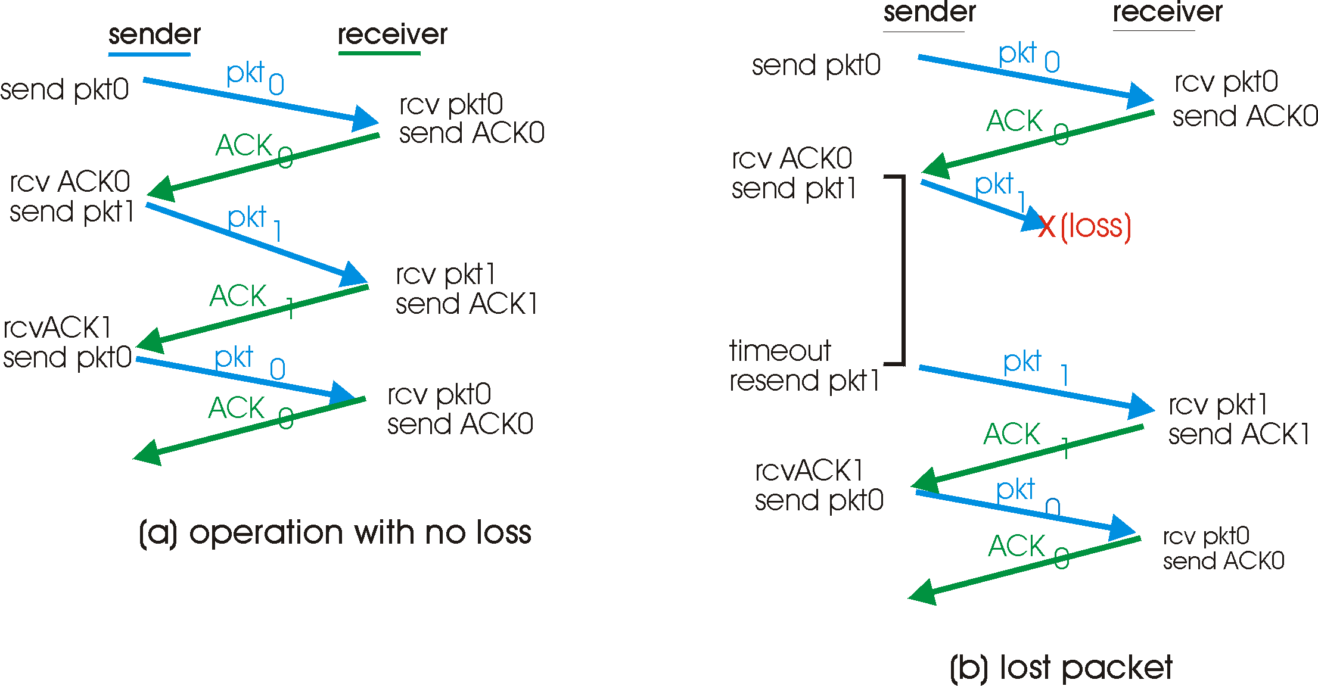
rdt3.0 in action

Slide 59
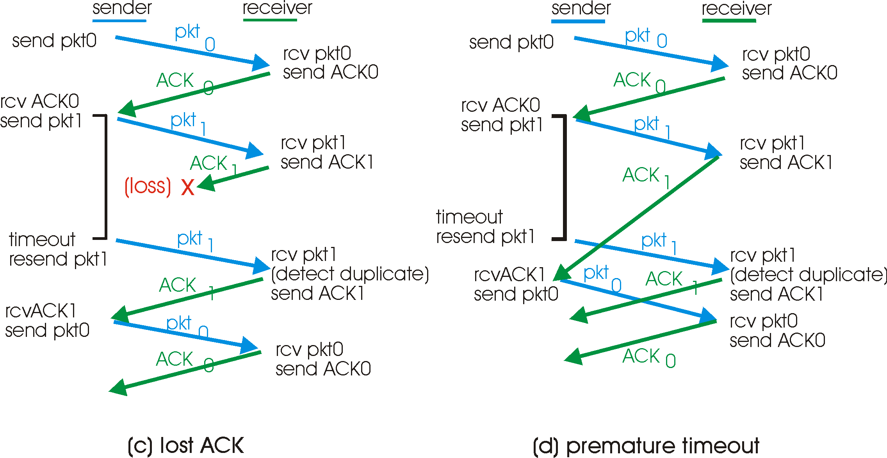
rdt3.0 in action

Slide 60
Performance of rdt3.0
rdt3.0 works, but performance stinks
ex: 1 Gbps link, 15 ms prop. delay, 8000 bit packet:
  U _{sender}: utilization – fraction of time sender busy sending
  1KB pkt every 30 msec -> 33kB/sec thruput over 1 Gbps link
  network protocol limits use of physical resources!

Slide 61
rdt3.0: stop-and-wait operation
sender
receiver
first packet bit transmitted, t = 0
last packet bit transmitted, t = L / R
first packet bit arrives
RTT
last packet bit arrives, send ACK
ACK arrives, send next
packet, t = RTT + L / R

Slide 62
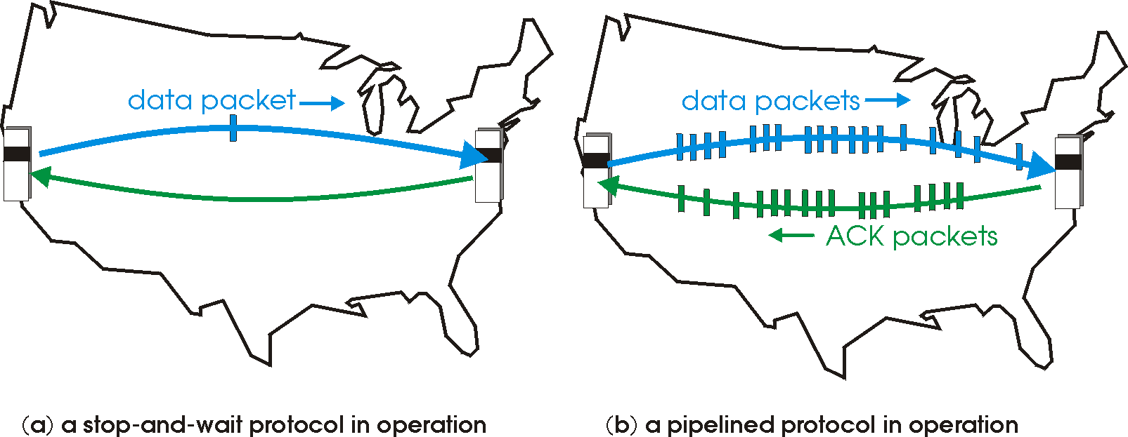
Pipelined protocols
Pipelining: sender allows multiple, “in-flight”, yet-to-be-acknowledged pkts
  range of sequence numbers must be increased
  buffering at sender and/or receiver
Two generic forms of pipelined protocols: go-Back-N, selective repeat

Slide 63
Pipelining: increased utilization
sender
receiver
first packet bit transmitted, t = 0
last bit transmitted, t = L / R
first packet bit arrives
RTT
last packet bit arrives, send ACK
last bit of 2nd packet arrives, send ACK
last bit of 3rd packet arrives, send ACK
ACK arrives, send next
packet, t = RTT + L / R
Increase utilization
by a factor of 3!

Slide 64
Pipelining Protocols
Go-back-N: big picture:
Sender can have up to N unacked packets in pipeline
Rcvr only sends cumulative acks
  Doesn’t ack packet if there’s a gap
Sender has timer for oldest unacked packet
  If timer expires, retransmit all unacked packets
Selective Repeat: big pic
Sender can have up to N unacked packets in pipeline
Rcvr acks individual packets
Sender maintains timer for each unacked packet
  When timer expires, retransmit only unack packet

Slide 65
Selective repeat: big picture
Sender can have up to N unacked packets in pipeline
Rcvr acks individual packets
Sender maintains timer for each unacked packet
  When timer expires, retransmit only unack packet

Slide 66
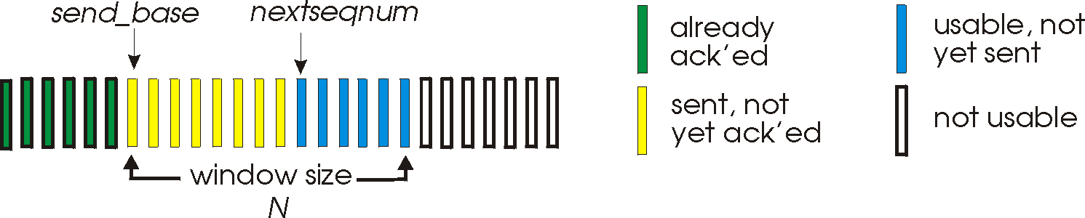
Go-Back-N
Sender:
k-bit seq # in pkt header
“window” of up to N, consecutive unack’ed pkts allowed
send_base: oldest unacked packet
nextseqnum: smallest unused seqnum
nextseqnum - send_base ≤Sender Window Size (SWS=N)
ACK(n): ACKs all pkts up to, including seq # n - “cumulative ACK”
  may receive duplicate ACKs (see receiver)
timer for each in-flight pkt
timeout(n): retransmit pkt n and all higher seq # pkts in window

Slide 67
GBN: sender extended FSM
rdt_send(data)
if (nextseqnum < base+N) {
sndpkt[nextseqnum] = make_pkt(nextseqnum,data,chksum)
udt_send(sndpkt[nextseqnum])
if (base == nextseqnum)
start_timer
nextseqnum++
}
else
refuse_data(data)
Λ
base=1
nextseqnum=1
timeout
Wait
start_timer
udt_send(sndpkt[base])
udt_send(sndpkt[base+1])
…
udt_send(sndpkt[nextseqnum-1])
rdt_rcv(rcvpkt)
&& corrupt(rcvpkt)
Λ
rdt_rcv(rcvpkt) &&
notcorrupt(rcvpkt)
base = getacknum(rcvpkt)+1
If (base == nextseqnum)
stop_timer
else
restart_timer

Slide 68
GBN: receiver extended FSM
default
udt_send(sndpkt)
rdt_rcv(rcvpkt)
&& notcurrupt(rcvpkt)
&& hasseqnum(rcvpkt,expectedseqnum)
Λ
Wait
extract(rcvpkt,data)
deliver_data(data)
sndpkt = make_pkt(expectedseqnum,ACK,chksum)
udt_send(sndpkt)
expectedseqnum++
expectedseqnum=1
sndpkt =
make_pkt(expectedseqnum,ACK,chksum)
ACK-only: always send ACK for correctly-received pkt with highest in-order seq #
  may generate duplicate ACKs
  need only remember expectedseqnum
out-of-order pkt:
  discard (don’t buffer) -> no receiver buffering!
    Is it bad?
  Re-ACK pkt with highest in-order seq #

Slide 69
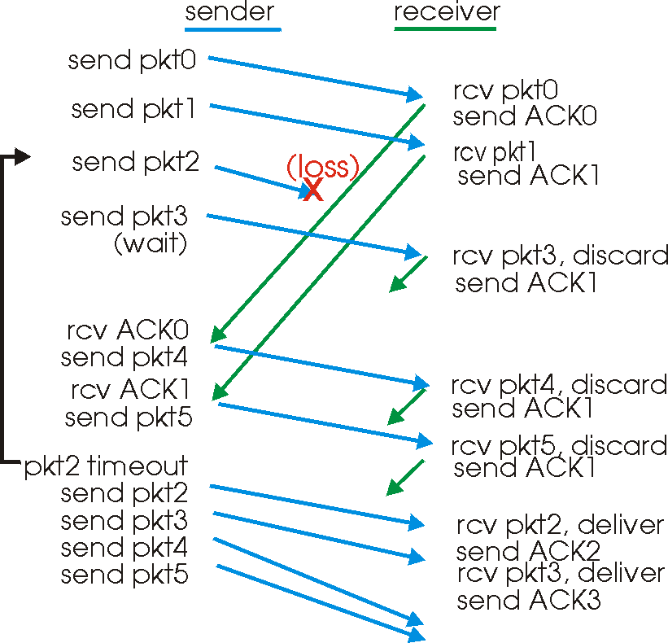
GBN in action

Slide 70
Selective Repeat
receiver individually acknowledges all correctly received pkts
  buffers pkts, as needed, for eventual in-order delivery to upper layer
sender only resends pkts for which ACK not received
  sender timer for each unACKed pkt
sender window
  N consecutive seq #’s
  again limits seq #s of sent, unACKed pkts

Slide 71
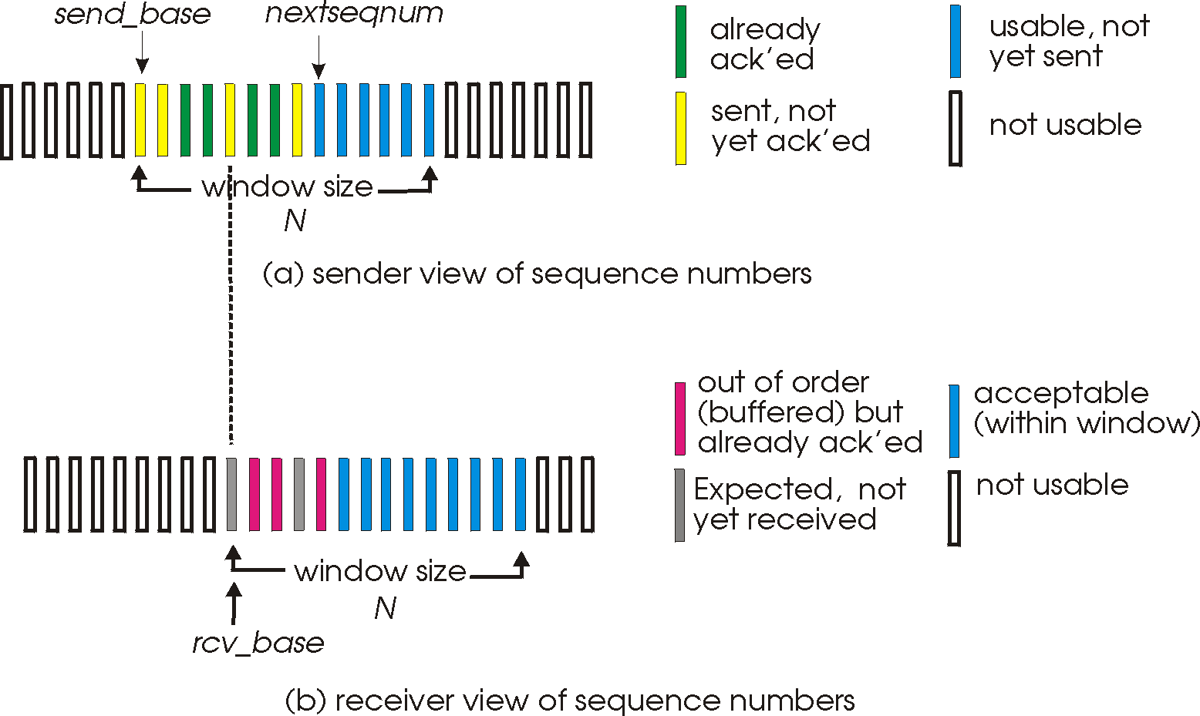
Selective repeat: sender, receiver windows

Slide 72
Selective repeat
sender
receiver
pkt n in [rcvbase, rcvbase+N-1]
send ACK(n)
out-of-order: buffer
in-order: deliver (also deliver buffered, in-order pkts), advance window to next not-yet-received pkt
pkt n in [rcvbase-N,rcvbase-1]
ACK(n), why?
otherwise:
ignore
data from above :
if next available seq # in window, send pkt
timeout(n):
resend pkt n, restart timer
ACK(n) in [sendbase,sendbase+N]:
mark pkt n as received
if n smallest unACKed pkt, advance window base to next unACKed seq #

Slide 73
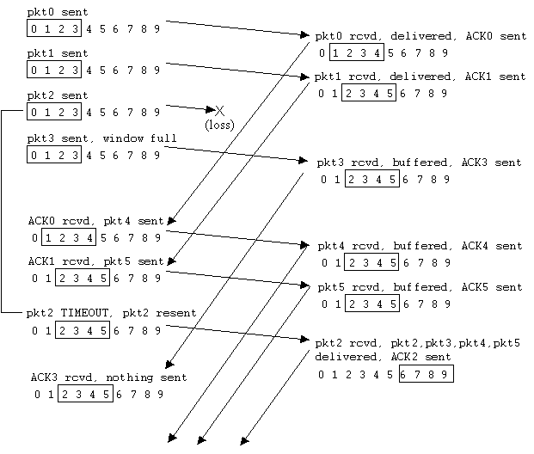
Selective repeat in action

Slide 74
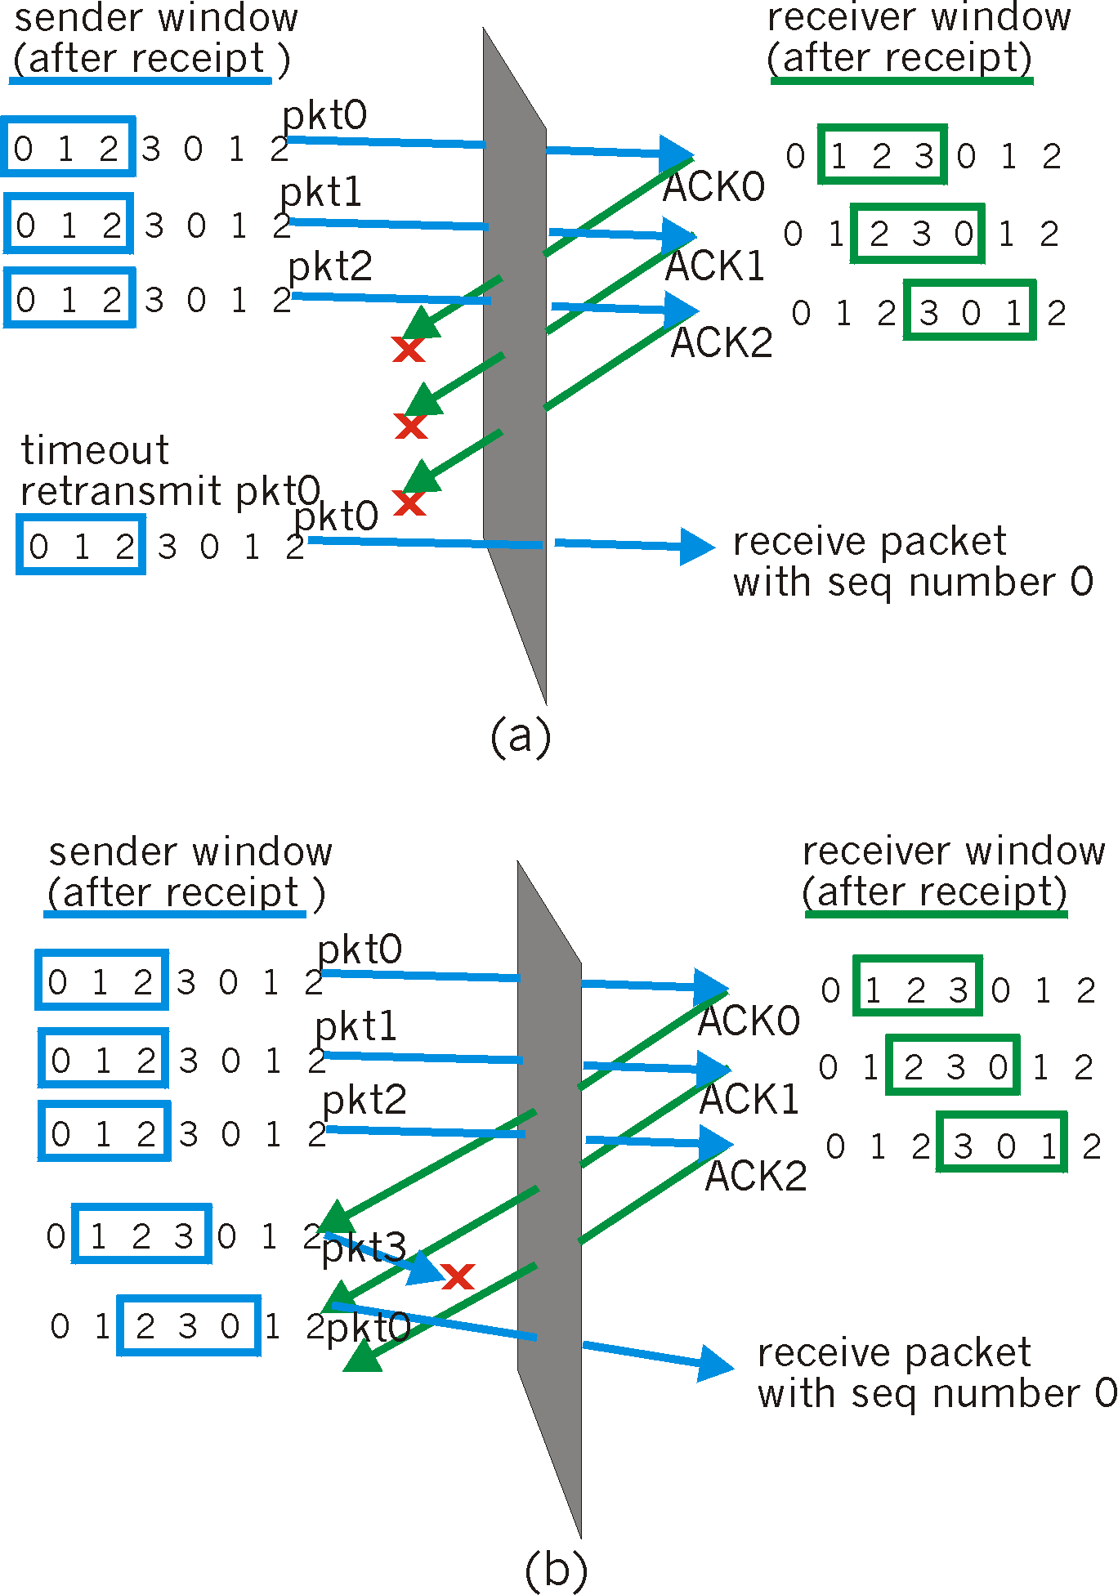
Selective repeat: dilemma
Example:
seq #’s: 0, 1, 2, 3
window size=3
receiver sees no difference in two scenarios!
incorrectly passes duplicate data as new in (a)
Q: what relationship between seq # size and window size?

Slide 75
Relationship b/w seq# & window sizes
LAF – LFR <= RWS
  where LAF: Largest Acceptable frame
  LFR: recv_base – 1: Last Frame Received
RWS=1 for Go-Back-N protocol
RWS <= SWS for Selective Repeat proto
When RWS=1, SWS <= N -1 (N=size of seq# space= 2^k for k-bit seq no field)
When RWS=SWS, SWS <= N/2
SW protocol alternates b/w two halves of seq# space
It also continually slides b/w two halves rather than discretely alternating b/w them

Slide 76


